Slide 1
Thinking Beyond the Checkbook
Increase charitable gifts with effective ways to give smarter

Slide 2
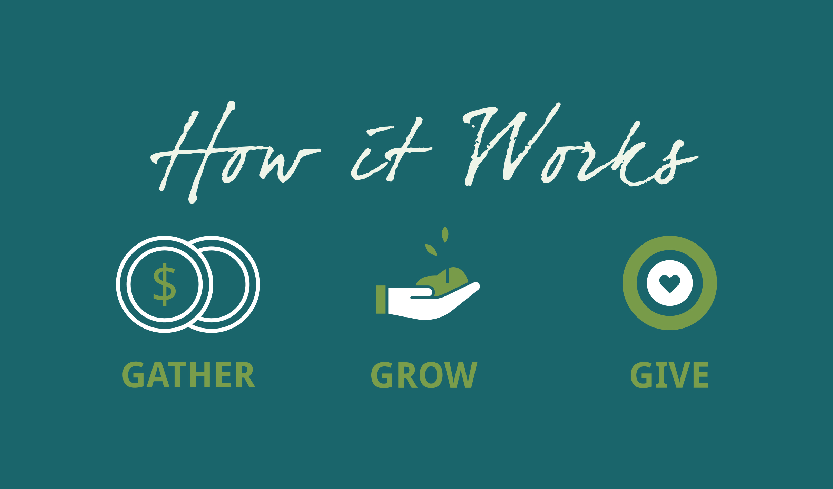

Slide 3



Gather, Grow, Give
We Gather. We receive gifts from donors.
We Grow. We invest these funds, allowing them to grow over time and increasing the collective impact we can make.
We Give. Our fundholders and affiliates direct funding to nonprofits and scholarships to students in communities across North Carolina and beyond. This means fundholders can build a legacy of giving for generations to come.

Slide 4
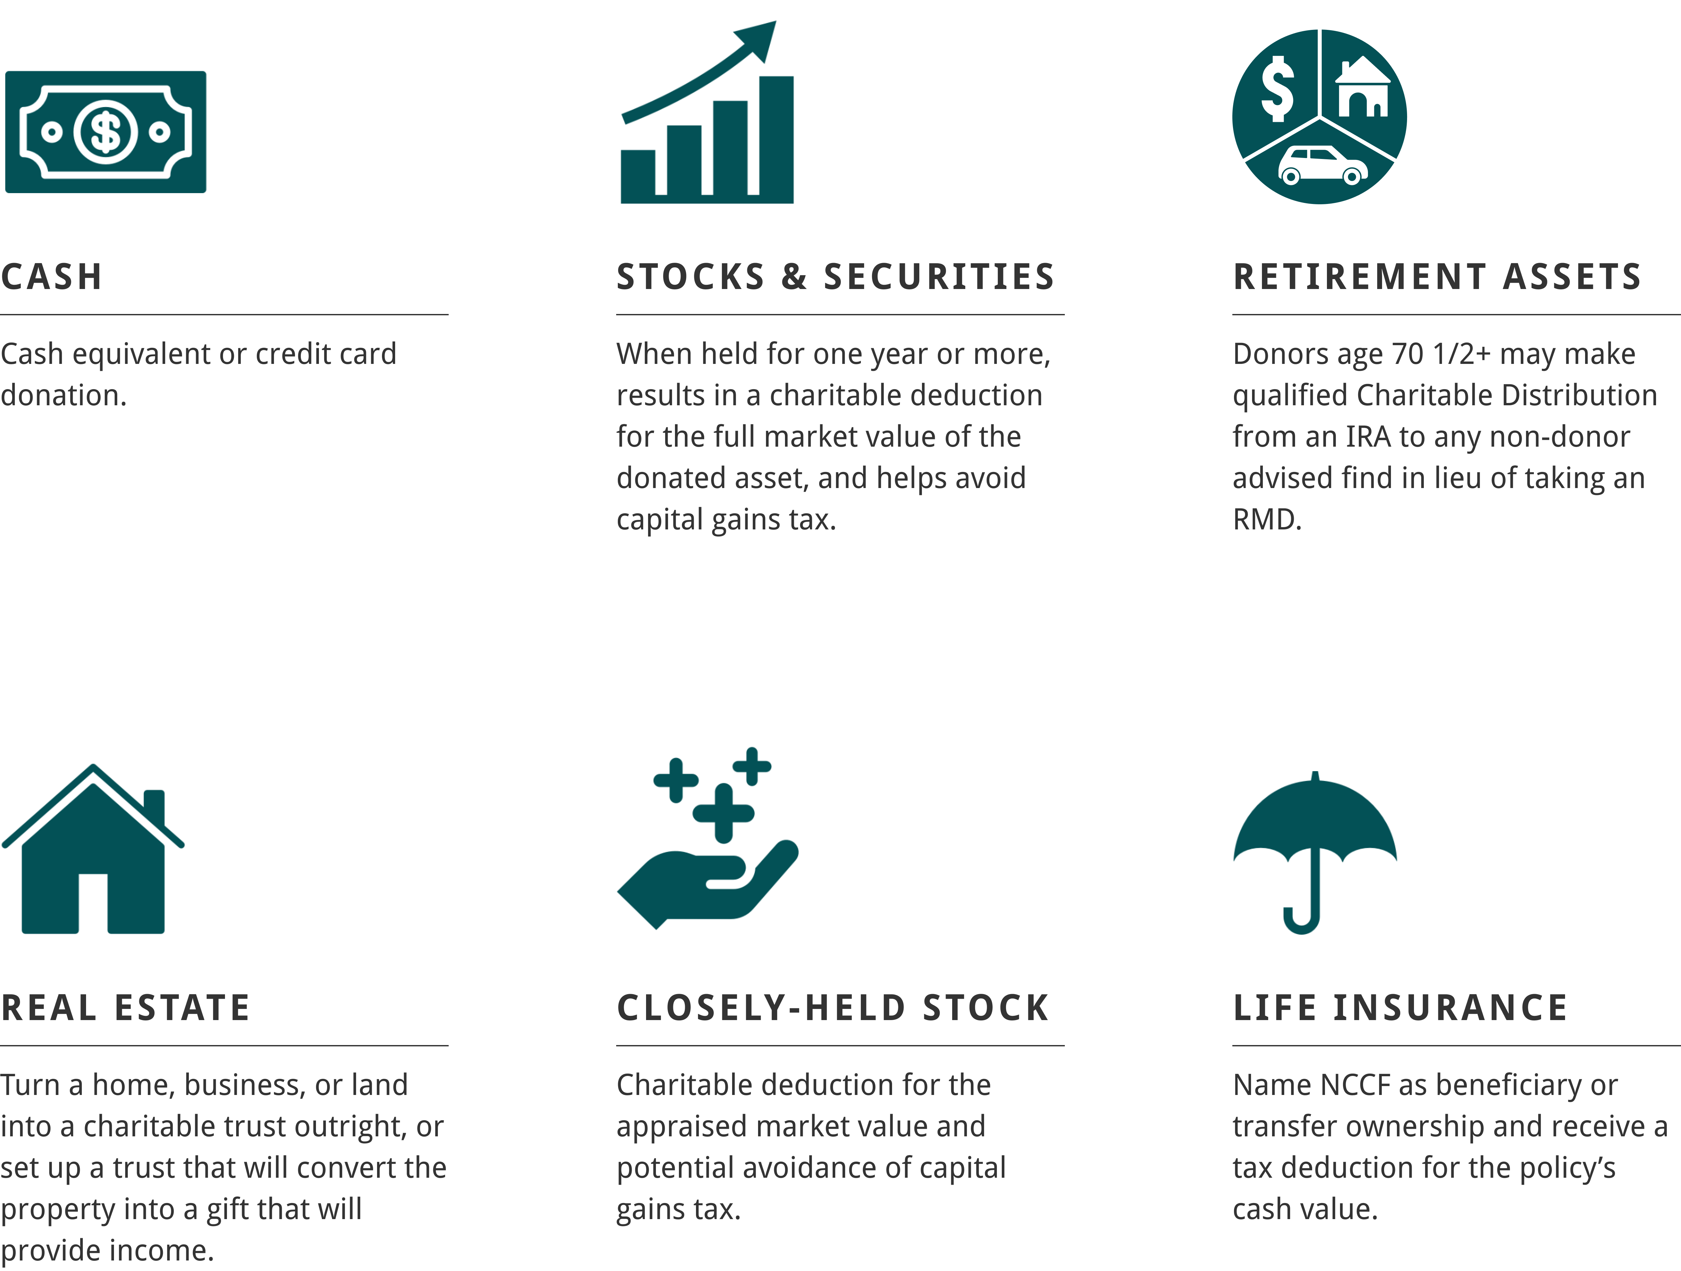
Transforming Assets into Gifts

Slide 5

Gifts of Stock
Why would a donor gift stock?
Lots of appreciated stock out there
Bypass capital gains
Fair market value deduction
  Giving instructions:
  Institution: Morgan Stanley
  Account: North Carolina Community Foundation
  Account: 773-025252
  DTC: 0015
  DON’T FORGET TO:
  Notify NCCF of the incoming stock transfer!
  Include the name of the affiliate benefitting from the gift.

Slide 6

Qualified Charitable Distribution (QCD)
The Who What Why
Who: IRA account holders 70 ½ years old
What: Can gift up to $108,000 per account holder
Why: Money goes directly to NCCF (charity), so account holder isn’t responsible for taxes
  Key for individuals 73 and older who are required to take distributions (RMD)
  Giving instructions:
  Legal name: North Carolina Community Foundation, Inc.
  Federal Tax ID: 58-16611700
  Address: 3737 Glenwood Ave., Suite 460, Raleigh NC 27612
  Be sure to include the affiliate benefitting from the gift!

Slide 7

Donor Advised Fund (DAF)
A charitable checkbook
A DAF is a charitable giving account
Statistically larger gifts
  Giving instructions:
  Legal name: North Carolina Community Foundation, Inc.
  Federal Tax ID: 58-16611700
  Address: 3737 Glenwood Ave., Suite 460, Raleigh NC 27612
  Be sure to include the affiliate benefitting from the gift!

Slide 8

Silver lining for checks and credit card gifts
Charitable contribution for non-itemizers
New for 2026
Above the line deduction
  $1000 individual
  $2000 married couples filing jointly
Reminder: Contributions to donor advised funds are not eligible for this deduction!

